Slide 1
Learning Objective
To be able to:
Describe the types of radiation and some of its uses
Key Words:
Alpha, beta, gamma

Slide 2
Thursday, 16 February 2017
Radioactivity
Date and title in books. You need a pen, pencil & ruler.
Starter Activity – 5 minutes
Exam question

Slide 3
(F) Target 1-9 | Identify the three types of radiation Identify how we can detect radiation
(F/H) Target 4-9 | Describe the properties of the three types of radiation
(H) Target 5-9 | Explain why radiation is given out by some nuclei
Extension: Application of Knowledge Target 8/9 | Compare the types of radiation, linking their properties to their uses
Learning Outcomes

Slide 4
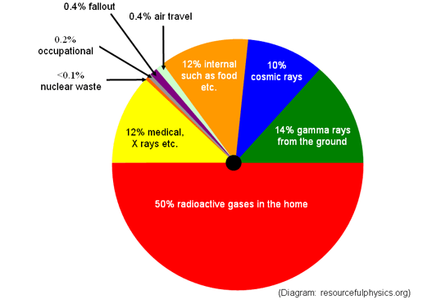
Sources of Background Radiation

Slide 5
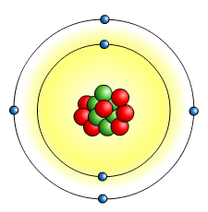

What is ‘radiation’?
The term radiation (also known as nuclear radiation) refers to the particles or waves emitted by radioactive substances.
Nuclear radiation comes from the nucleus of a radioactive atom.
electron
An atom has electrons orbiting the outside and a central nucleus, which is made up of protons and neutrons.
proton
neutron
In a radioactive atom, the nucleus is unstable and so it emits particles or waves to form a more stable atom.
This process is called radioactivity or radioactive decay. It is a natural and completely spontaneous process.

Slide 6


What is radioactive decay?
Notes:
Teacher notes
This activity, summarising the three types of radiation, could be used to introduce the topic of radiation, as a plenary exercise or as a revision exercise.

Slide 7

What is alpha (α) radiation?
Description
2 neutrons, 2 protons
Note:– An alpha particle is the same as a helium nucleus
Electric charge
+2
4
Relative atomic mass
Penetrating power
Stopped by paper or a few centimetres of air
Ionizing effect
Strongly ionising
Effect of magnetic/ electric field
Weakly deflected

Slide 8

What is beta (β) radiation?
Description
High energy electron
Electric charge
-1
1/1860
Relative atomic mass
Penetrating power
Stopped by a few millimetres of aluminium
Ionizing effect
Weakly ionising
Effect of magnetic/ electric field
Strongly deflected

Slide 9

Gamma (γ) radiation
Description
High energy electromagnetic radiation
Electric charge
0
0
Relative atomic mass
Penetrating power
Stopped by several centimetres of lead or several metres of concrete
Ionizing effect
Very weakly ionising
Effect of magnetic/ electric field
Not deflected

Slide 10
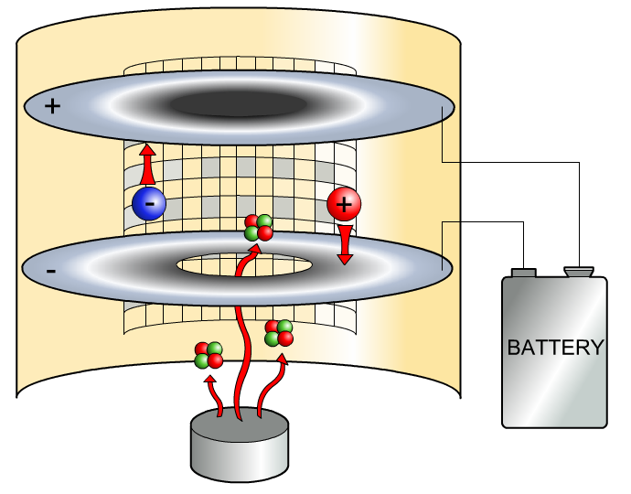
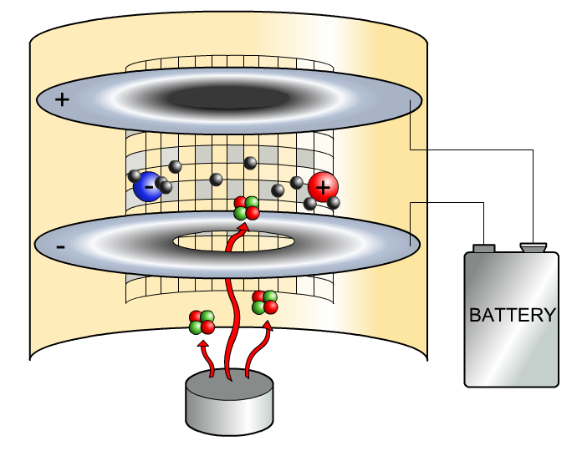
How can radiation detect a fire?
Smoke alarms contain a weak source of alpha radiation.
The alpha particles ionize the air.
If there is smoke present, it interacts with the ions produced by the alpha particles and ionization is reduced.
smoke particle
α
This means that less current is flowing through the air, which causes the alarm to sound.
α
Notes:
Teacher notes
How a smoke alarm works:
The ionization chamber made of two metal plates a small distance apart. One of the plates carries a positive charge, the other a negative charge. Between the two plates, air molecules are ionized by the alpha particles from the radioactive material. The result is positively charged oxygen and nitrogen ions in the air. The free electrons are negatively charged.
The positive ions flow toward the negative plate, as the negative electrons flow toward the positive plate. The movement of the electrons registers as a small but steady flow of current. When smoke enters the ionization chamber, the current is disrupted as the smoke particles attach to the charged ions and restore them to a neutral electrical state. This reduces the flow of electricity between the two plates in the ionization chamber. When the electric current drops below a certain threshold, the alarm is triggered.

Slide 11
How is radiation used in making paper?
Notes:
Teacher notes
This five-stage animation sequence shows how beta radiation is used commercially to help control paper thickness in a paper mill.

Slide 12
How can radiation find leaks in pipes?
Notes:
Teacher notes
This four-stage animation sequence shows how beta radiation can also be used to detect the location of cracks in a leaking pipe without having to dig up the whole pipe.

Slide 13
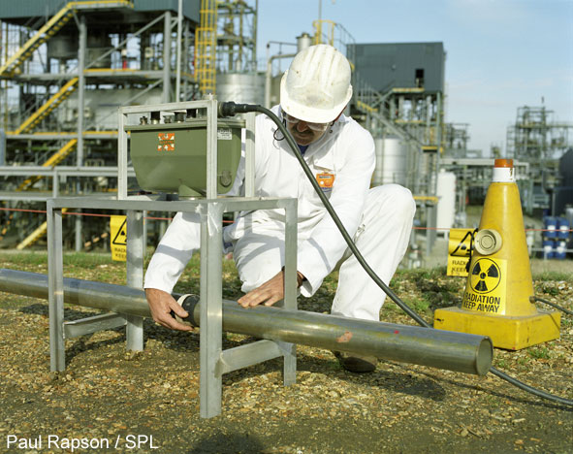
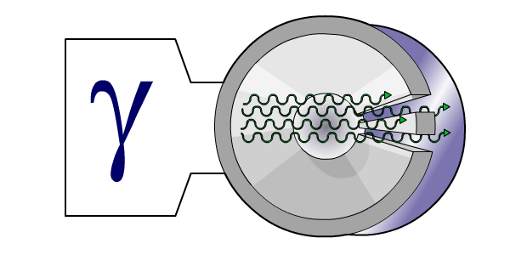
How can radiation detect cracks?
Gamma rays can also be used to detect cracks after an object has been welded.
Gamma rays are like X-rays.
welded metal pipe
welding flaws
If a gamma source is placed on one side of the welded metal, and a photographic film on the other side, any flaws will show up on the film like an X-ray.
photographic film
Notes:
Photo credit: © PAUL RAPSON / SCIENCE PHOTO LIBRARY
Teacher notes
Image shows radiographic testing of a pipe. The technician is using an X-ray machine to check the pipe for flaws, such as poor welding. The machine (green) sends X-rays through the pipe to radiographic film beneath it (black, taped to the bottom of the pipe). The X-rays are absorbed depending on the thickness and density of the metal, revealing areas that are too thin to be considered safe.
As gamma rays are like x-rays, the technique would be exactly the same if the technician was using a gamma source instead of x-rays.

Slide 14

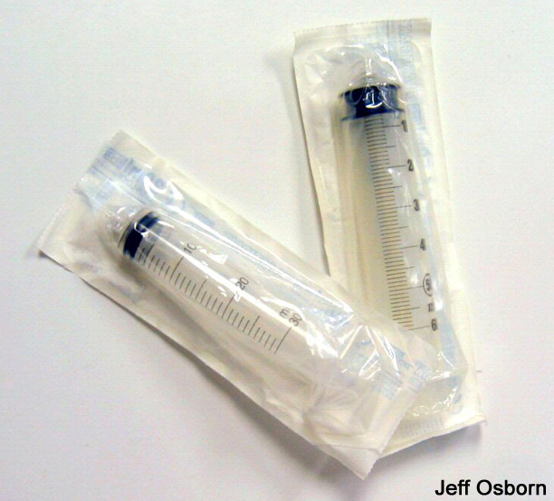
How is radiation used for sterilization?
Gamma rays are used to kill bacteria, mould and insects in food.
This can be done even after the food has been packaged. It can affect the taste, but supermarkets like it because it lengthens the shelf life.
Gamma rays are also used to kill bacteria on medical equipment.
It is particularly useful with plastic equipment that would be damaged by heat sterilization.
Notes:
Photo credit (top right): Gaston Thauvin
Photo credit (bottom left) : Jeff Osborn

